Slide 1
Cloud-Based Distributed Weather Forecasting System Using Real-Time Data
By:
Samir Sanyal, Vraj Parekh, Rajat Sawant and Dev Patel

Slide 2
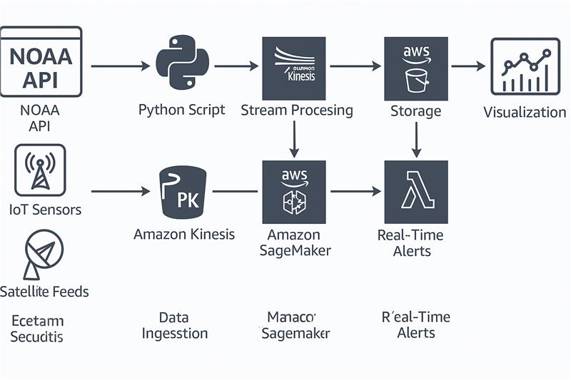
Introduction
The goal of our project is to develop a scalable, real-time weather forecasting system that leverages cloud-based data ingestion, cleaning, machine learning, and alerting.
Traditional batch-based forecasting systems, such as NOAA’s GFS, often suffer from high latency and limited scalability, especially during periods of extreme weather when timely data is most critical.
Our system is designed to reduce forecast latency to under five minutes and to handle large spikes in data volume, providing more responsive and accurate forecasts.
Our codebase includes scripts for downloading data from S3, preprocessing and scaling features, and defining a custom PyTorch dataset for sequence-to-sequence prediction.
The LSTM model is implemented as an encoder-decoder architecture, and the training loop uses the Adam optimizer and mean squared error loss. After training, the model is saved and uploaded to S3 for deployment.

Slide 3
Team & Roles
Name | Role
Samir Sanyal | AWS Infrastructure & Data Ingestion
Vraj Parekh | Lambda & S3 Integration
Rajat Sawant | Dataset Cleaning & Storage
Dev Patel | SageMaker Model & Visualization

Slide 4
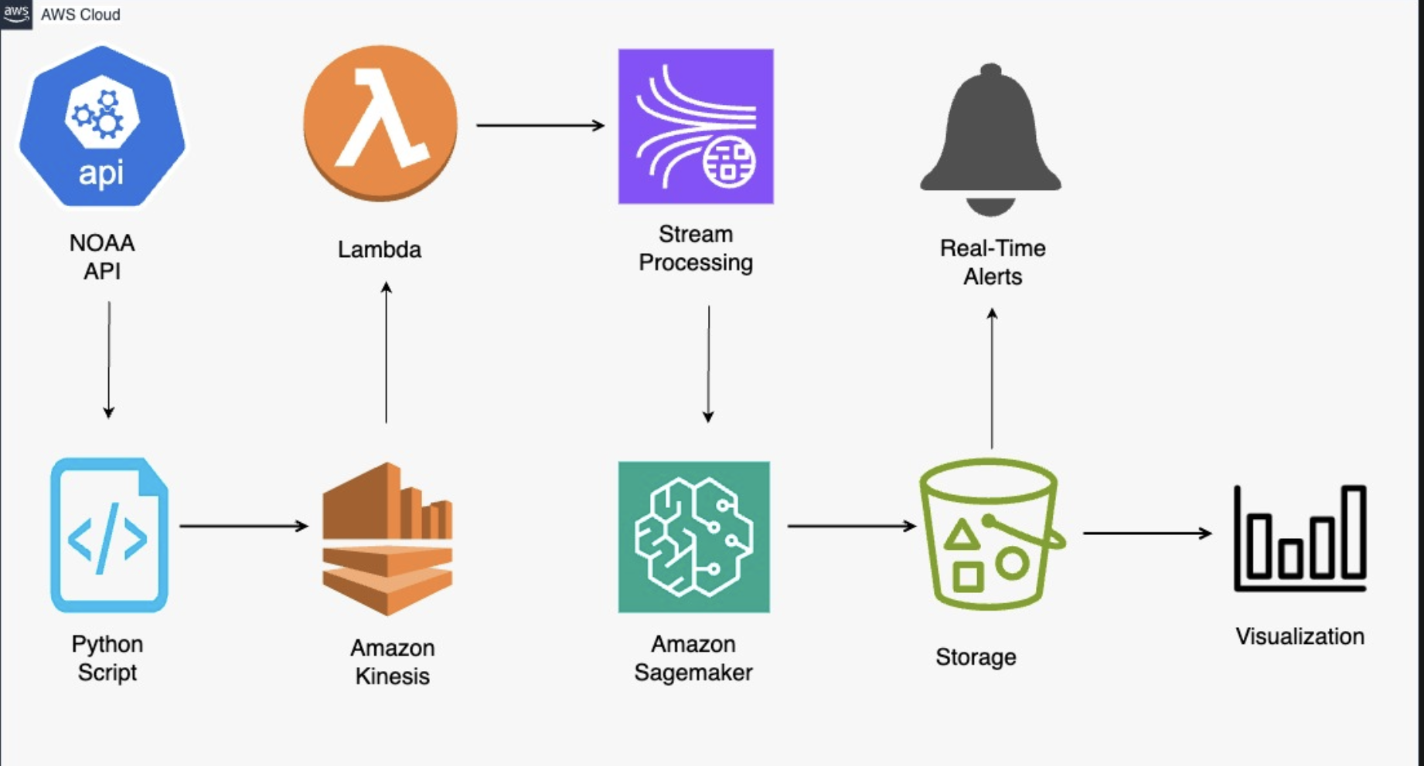
Overview
The architecture of our system begins with a Python script that fetches weather data from the NOAA API.
This data is streamed in real time using Amazon Kinesis, which allows for high-throughput data ingestion.
AWS Lambda functions process the streamed data, validate it, and store it in Amazon S3, partitioned by date for easy retrieval.
This cleaned data is used to train an LSTM (Long Short-Term Memory) forecasting model on Amazon SageMaker.
The system also includes Lambda-triggered alerts for costs and weather events, and visualizations are provided through Streamlit dashboards.

Slide 5
Data Pipeline
Our data pipeline is designed for reliability and scalability.
A Python script continuously polls the NOAA API, handling retries in case of failures, and publishes the weather data as JSON records to Kinesis.
Kinesis streams the data to Lambda, which batches and validates the records before storing them in S3.
Then python script deployed on Lambda merges and cleans these JSON files into a single CSV file, selecting the most relevant weather features such as temperature, wind, and precipitation.
The cleaned datasets are archived in S3, supporting both model training and future analysis.

Slide 6
Machine Learning Model
The core of our forecasting system is an LSTM neural network, which is well-suited for time series prediction.
The model takes as input 14 days of historical weather features and predicts conditions for the next seven days.
Data preprocessing includes filling missing values and scaling features using a MinMaxScaler.
We implemented a custom PyTorch dataset for sequence-to-sequence prediction, and the model itself is an encoder-decoder LSTM with either 64 or 128 hidden units. The model is trained using the Adam optimizer and mean squared error loss over 20 epochs.
Once trained, the model is saved and uploaded to S3, ready for real-time inference.

Slide 7
Alerting and Visualization
To ensure proactive monitoring, our system includes both cost and weather alerts.
AWS Budgets and SNS are used to notify the team if cloud costs exceed a set threshold, while Lambda functions trigger weather alerts for severe conditions such as low temperatures or high winds.
For visualization, we use Streamlit to display time series forecasts and alert histories, enabling users to filter and drill down into the data for deeper insights.

Slide 8
Obstacles & Mitigations
Throughout the course of this project, we encountered a number of technical and operational challenges.
One significant obstacle was managing API rate limits imposed by NOAA, which we addressed by implementing exponential backoff and robust retry logic in our data collection scripts. The limited availability of historical data posed another challenge, which we mitigated by supplementing our dataset with batch history and developing fallback models for periods with sparse data.
Managing the costs associated with training machine learning models on Amazon SageMaker was also a concern, prompting us to utilize spot instances and local training environments whenever possible.
Visualization proved challenging due to compatibility issues with Power BI, so we adopted Streamlit as a flexible and reliable alternative. Finally, to prevent cost overruns, we established active monitoring and auto-scaling policies, ensuring that the system remains both efficient and cost-effective.

Slide 9
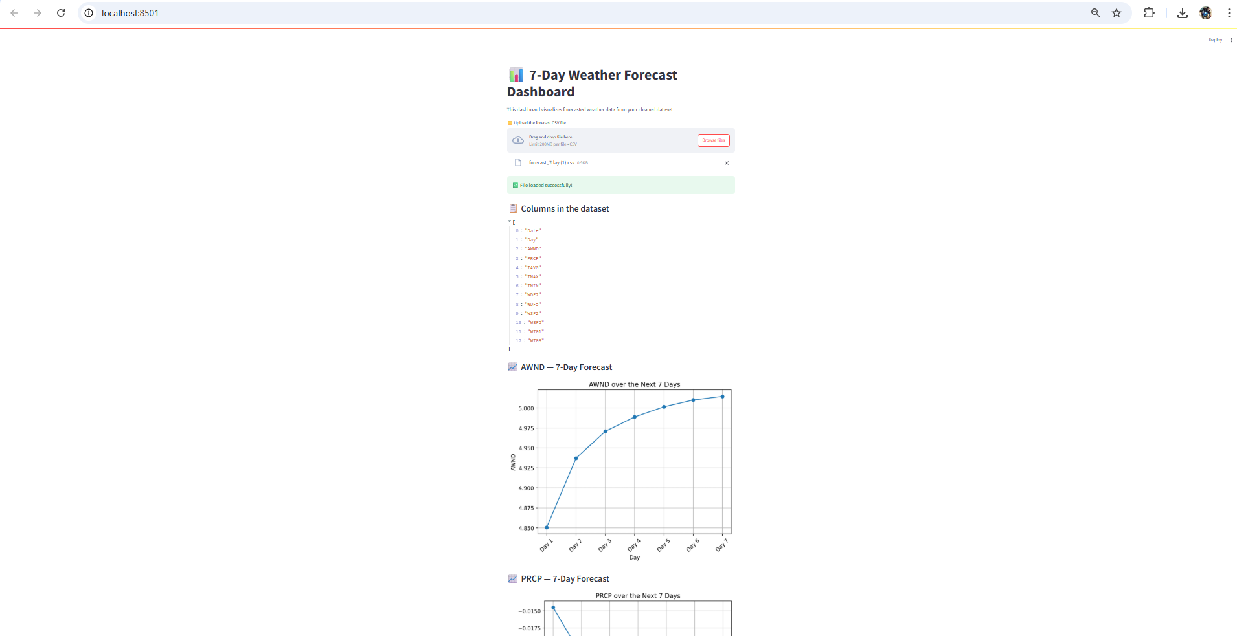

Slide 10
Conclusion
We have successfully implemented the real-time data pipeline from NOAA to Kinesis, Lambda, and S3, and have created a cleaned and structured dataset ready for machine learning. The cost alerting system is operational, and our LSTM model has been trained and deployed to S3.

